Slide 1
Hostel Management System Project Presentation

Slide 2
Title Slide
Title: Hostel Management System
Date: 10-Sep-23
Course: SPL-I

Slide 3
Introduction
Kazi Nahid
BSSE 1437
Institute of Information Technology
University of Dhaka

Slide 4
Motivation
Hostel life is a significant part of a student’s educational journey.
Imagine a place where students feel at ease in their living quarters, staff can manage hostel resources effortlessly and the communication between student and staff/manager becomes transparent. In that place student can give their best to their study.

Slide 5
Project Overview
Hostel management plays a crucial role in efficiently managing hostel resources, including rooms, facilities, and student data. It helps in maintaining order, providing a conducive environment for students, and ensuring their safety and well-being.
This Hostel Management System offers a comprehensive set of features, including Student Management, Room Allocation, Hostel Facilities Management, Fee Management, and a Complaints and Feedback system. These features streamline hostel operations and enhance the overall experience for both students and staff.
Implementing our system brings significant benefits, such as improved room allocation, efficient fee management, enhanced student experience, quick complaint handling, and robust access control. It ensures a seamless and organized hostel management process, contributing to a positive and productive hostel environment.

Slide 6
User Classes
This Hostel Management System caters to multiple user classes, each with distinct roles and responsibilities.
Students: Students can view room allocations, check hostel facilities, and submit complaints and feedback.
Staff: Staff members manage student records, handle room allocations, manage fee payments, and address complaints and feedback.
Admin: Administrators have overall control over the system, managing user accounts, system configurations, and ensuring the system's smooth operation.

Slide 7
Class Diagram
Among the key classes I've implemented are: Student Class: This class stores student information, including student ID, name, and other relevant data. Room Class: The Room class manages room-related details, such as room number and occupancy status. Staff Class: Staff members are represented by the Staff class, which contains information about staff ID, names, and roles. Facility Class: Facilities within the hostel are modeled using the Facility class. FeeRecord Class: Fee-related information, including student ID and amount, is tracked using the FeeRecord class. Complaint Class: Complaints from students are recorded using the Complaint class. Visitor Class: The Visitor class stores visitor data, including visitor ID and name. AttendanceRecord Class: This class records student attendance, including student ID, date, and whether it's in-time or out-time. Report Class: The Report class is responsible for generating reports and analytics. User Class: Users of the system are represented by the User class, which contains their usernames, passwords, and other attributes. These classes work together to form a robust and organized system, ensuring efficient hostel management.

Slide 8
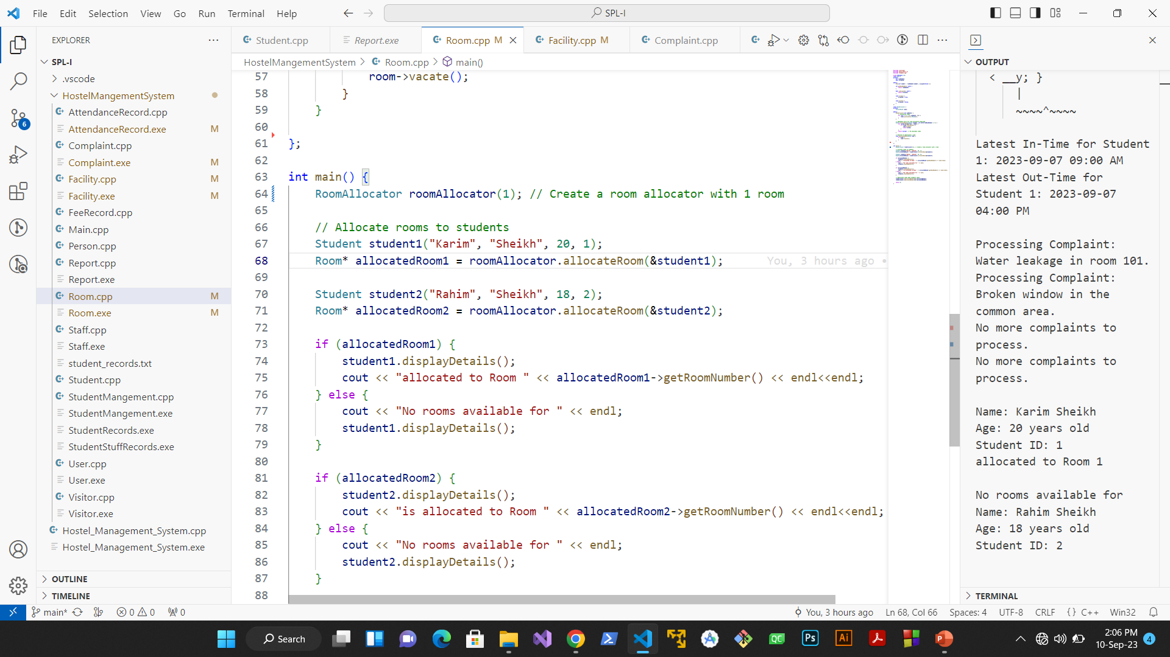
Progression
.

Slide 9
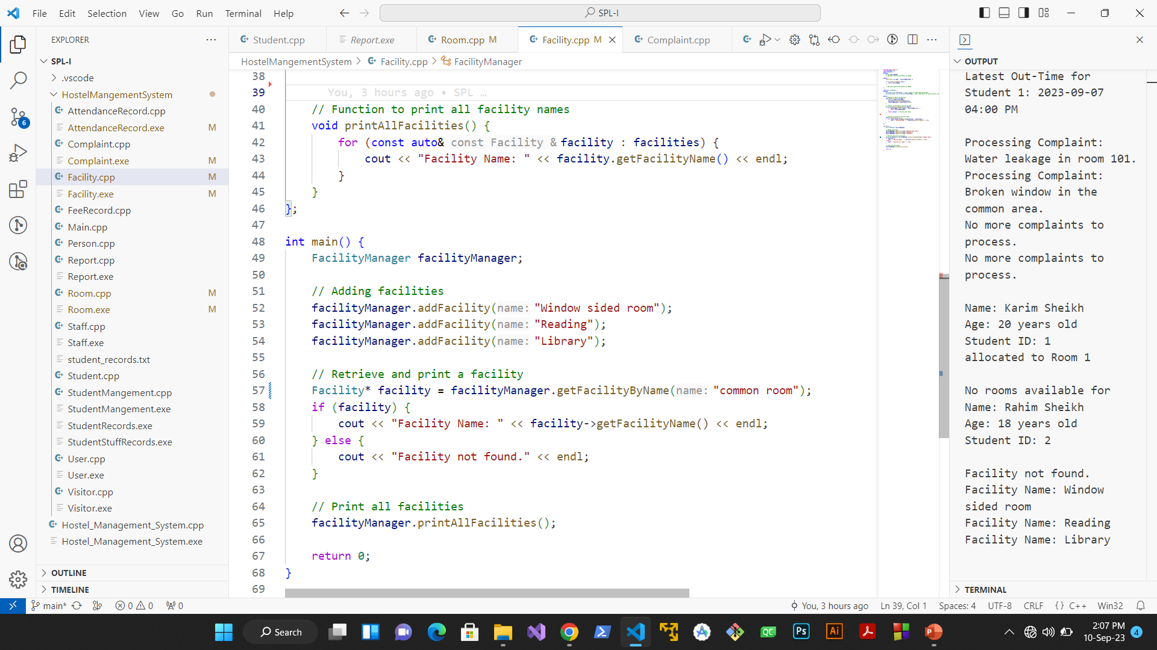
Progression
.

Slide 10
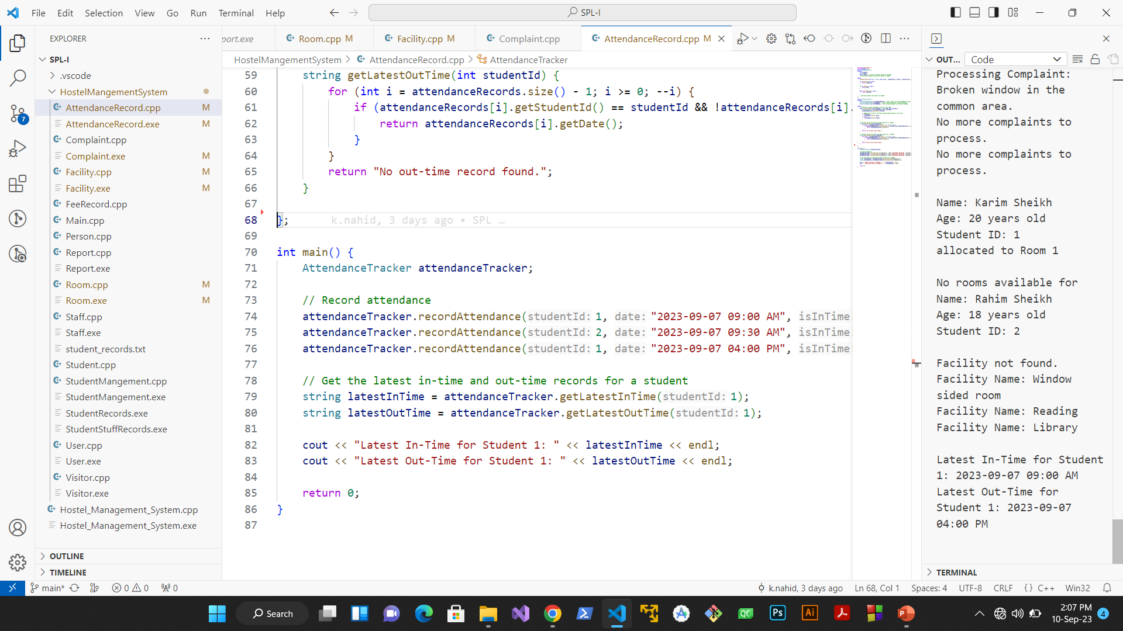
Progression
.

Slide 11
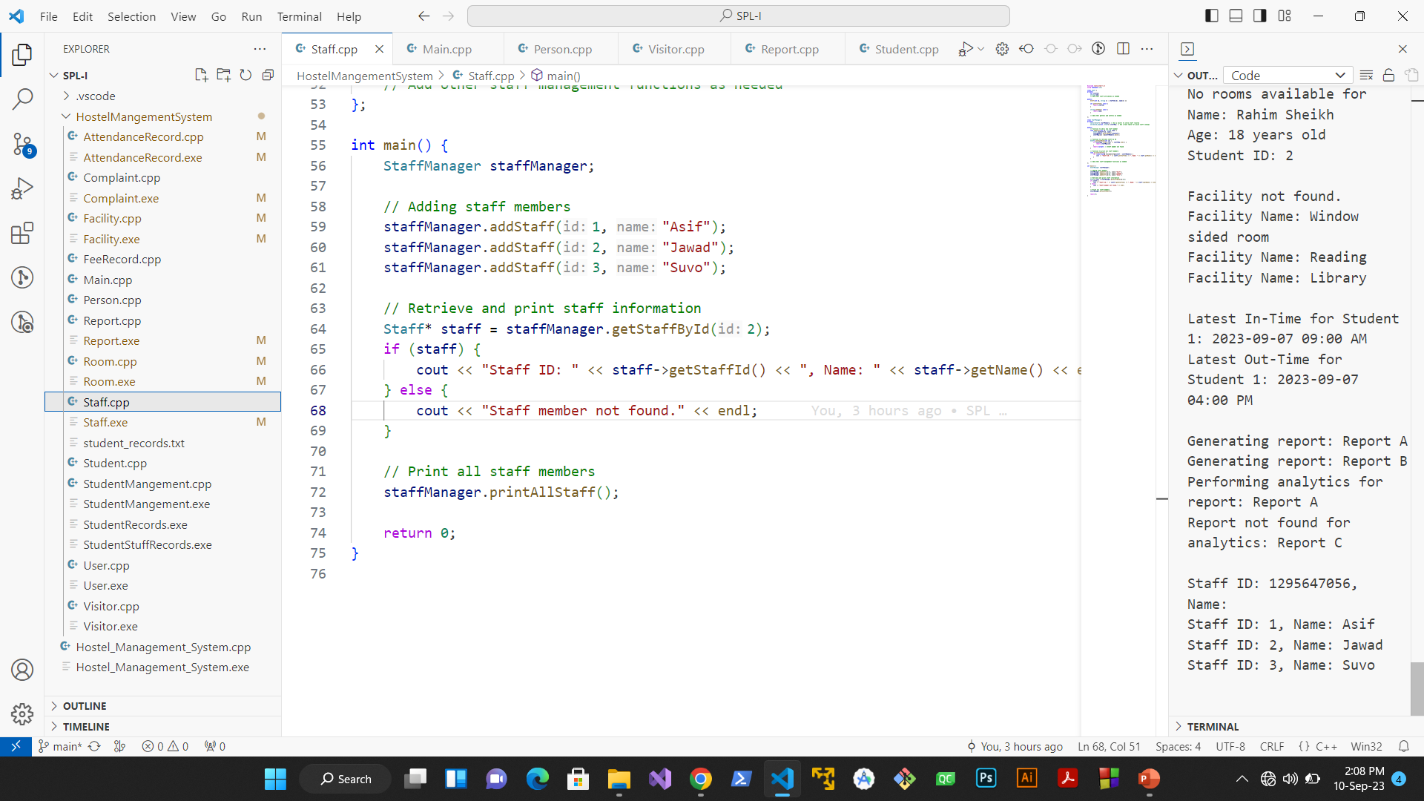
Progression
.

Slide 12
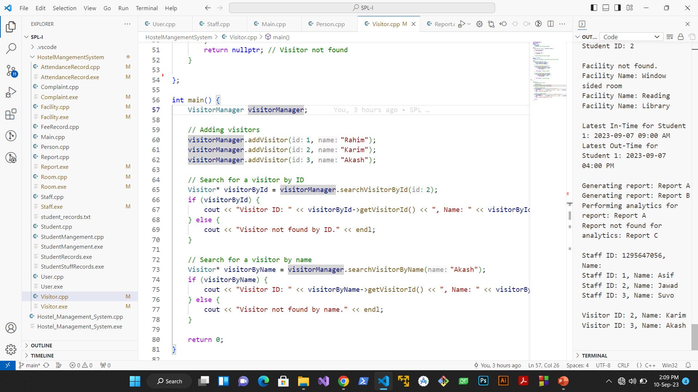
Progression
.

Slide 13
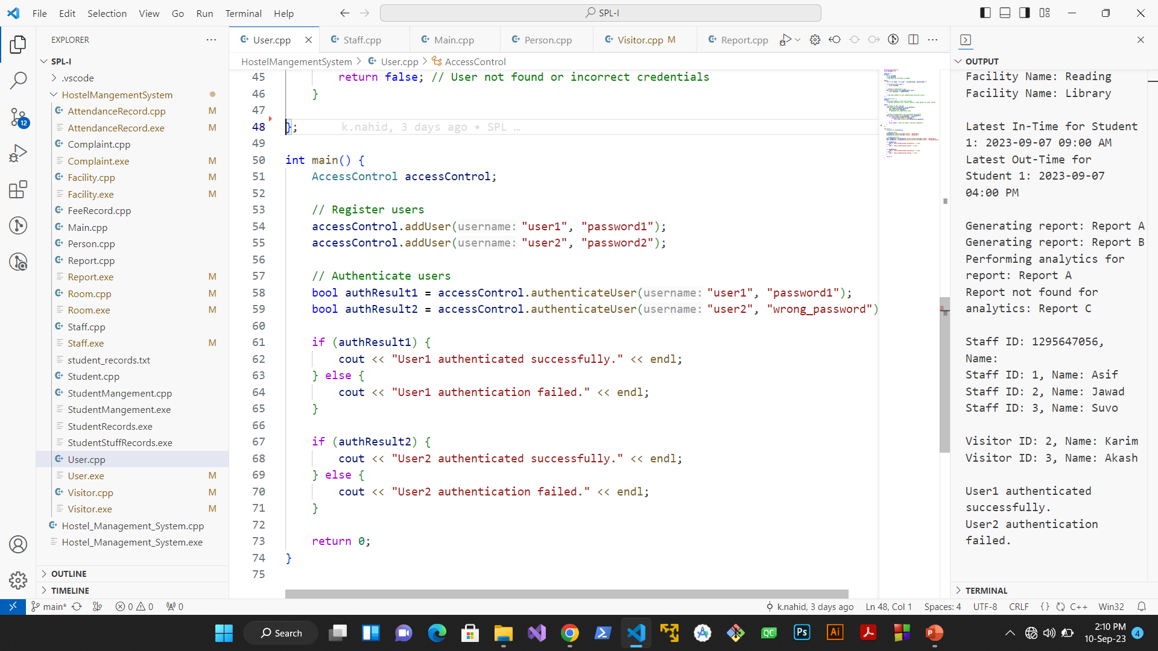
Progression
.

Slide 14
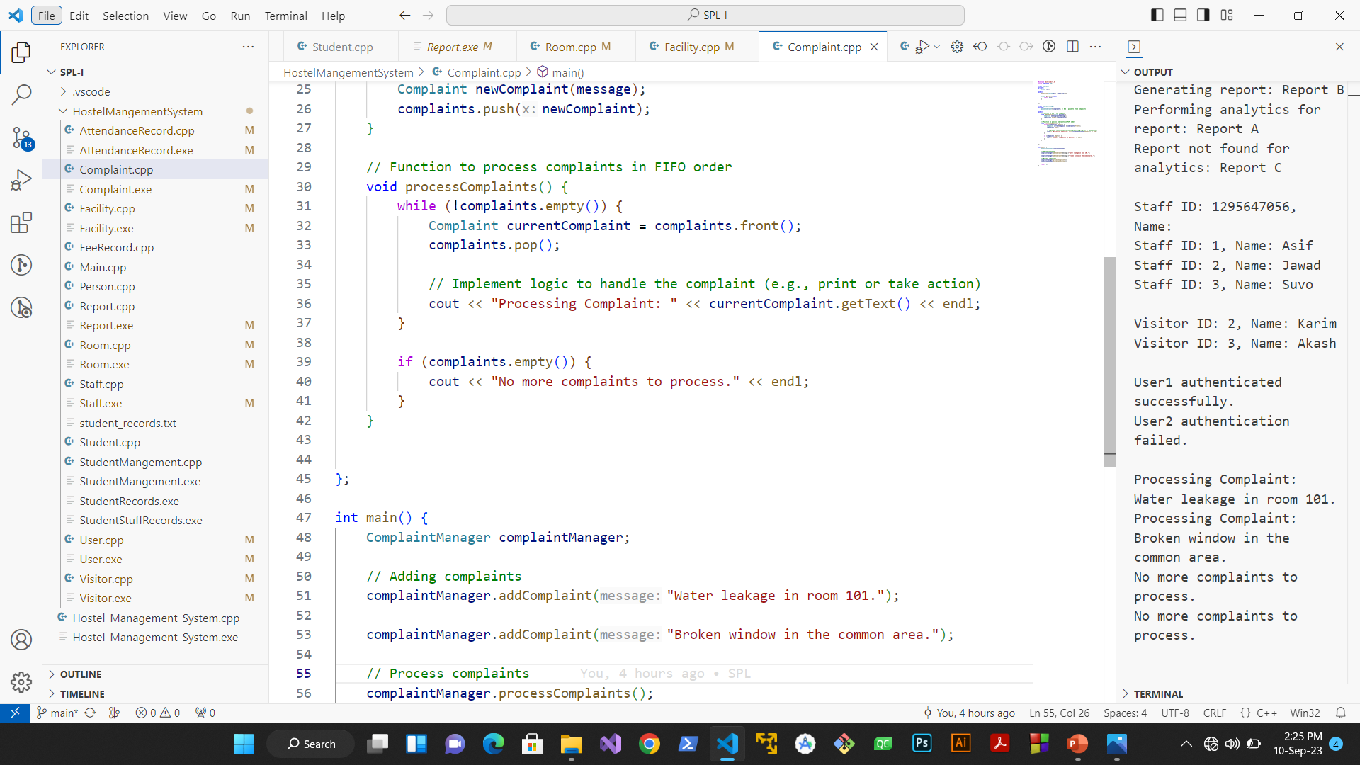
Progression
.

Slide 15
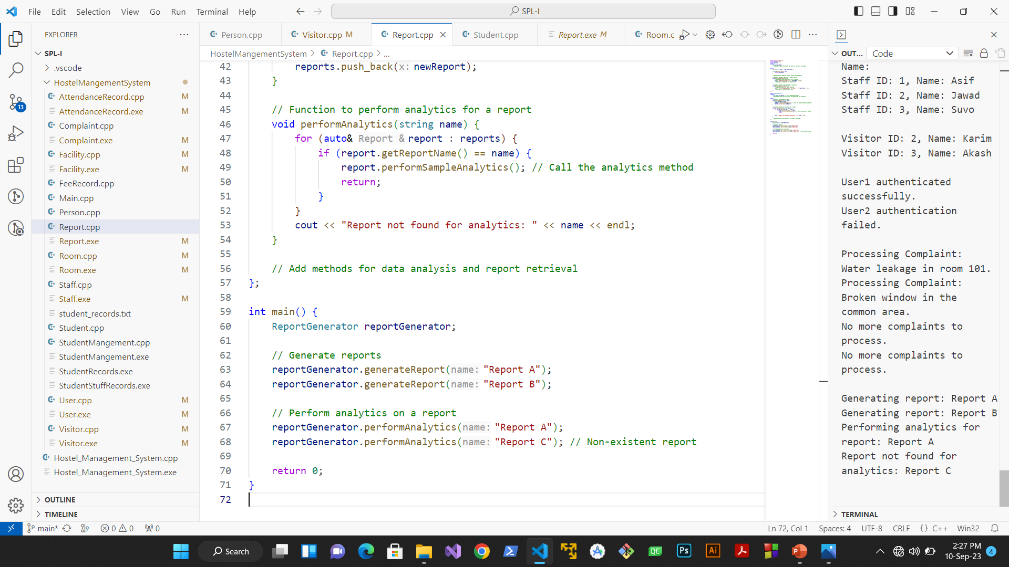
Progression
.

Slide 16
Future Enhancements
In the future, I envision further enhancing this Hostel Management System. Some ideas for future improvements include:
Combine Classes
Enhanced Graphics: Adding graphical elements to the user interface for a more visually appealing and user-friendly experience.
Mobile Application: Developing a mobile app version for convenient access and management on the go.

Slide 17
Conclusion
In conclusion, the Hostel Management System is a vital tool for hostel operations. I've covered key aspects such as its significance, architecture, user classes, and demonstrated functionalities.
Importance: This system plays a pivotal role in ensuring efficient room allocation, fee management, and a seamless student experience.
Future Directions: Looking ahead, we plan to enhance the system by introducing graphics, mobile accessibility, smart integration, and advanced analytics.
The Hostel Management System is poised to revolutionize hostel management, providing a secure, organized, and user-friendly environment for students and staff alike.

Slide 18
Thank You

